Slide 1
Lecture-11
Mathematics 2 (15B11MA211)
CO [C106.2]
Topic: Power Series
Reference for the lecture
B. S. Grewal, “Higher Engineering Mathematics” 44th edition, Khanna Publishers 2017.

Slide 2
Topics to be covered
Power Series
Convergence of Power Series
Solved Example
Uniform Convergence
Solved Example

Slide 3
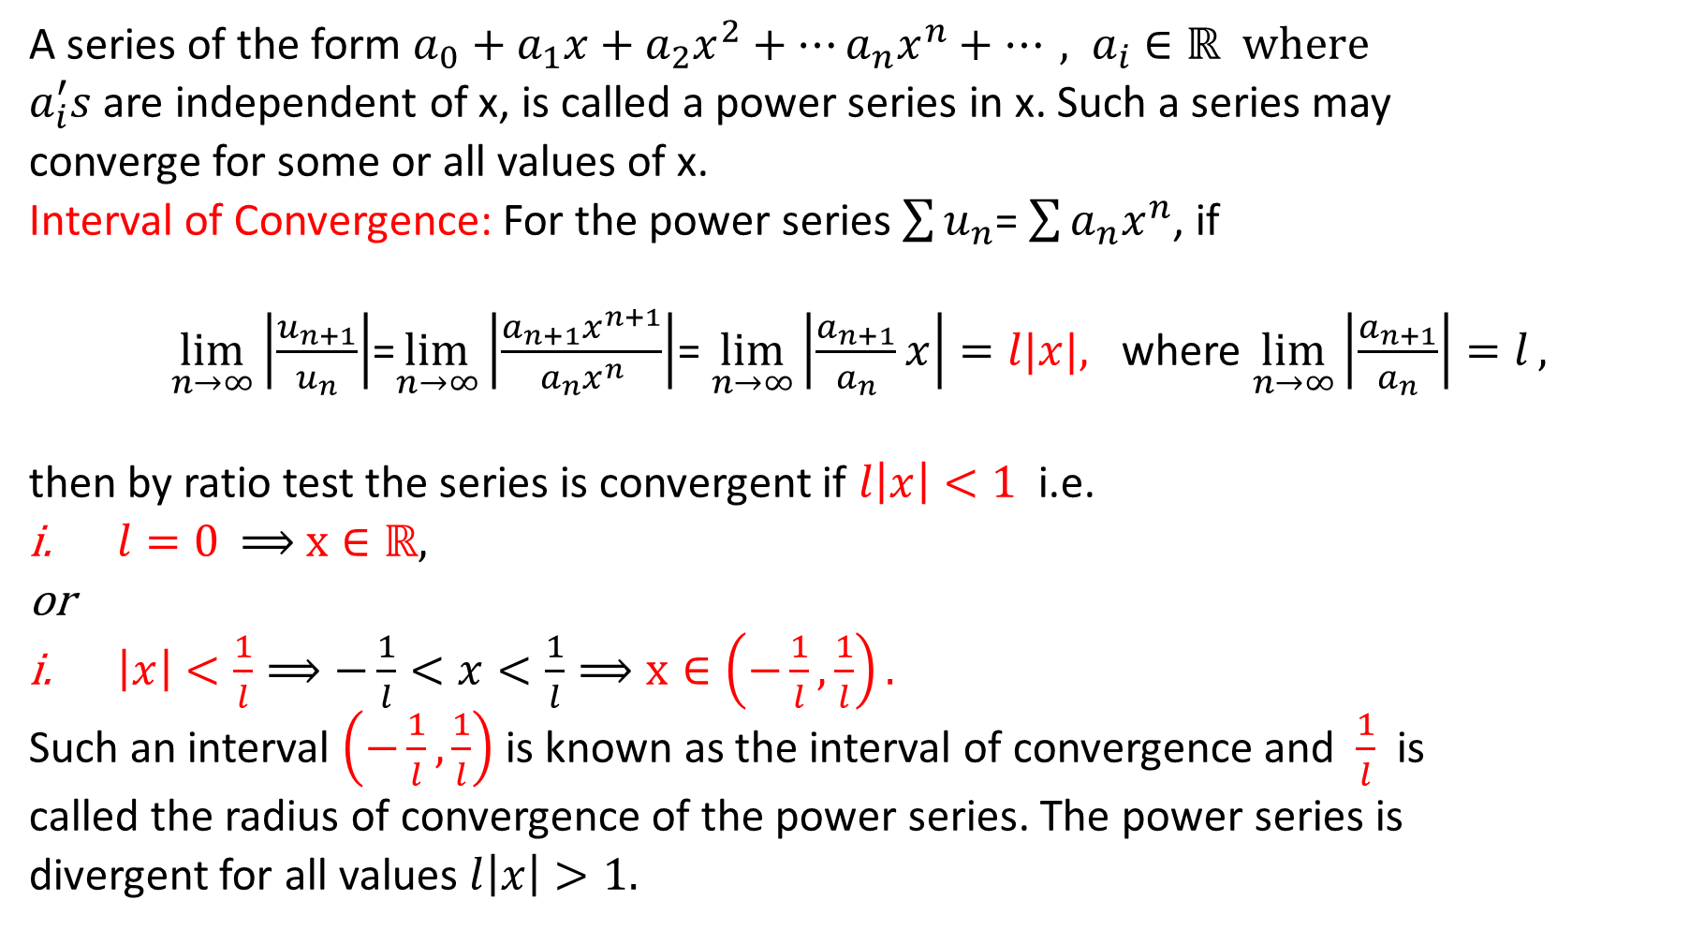
Power Series

Slide 4
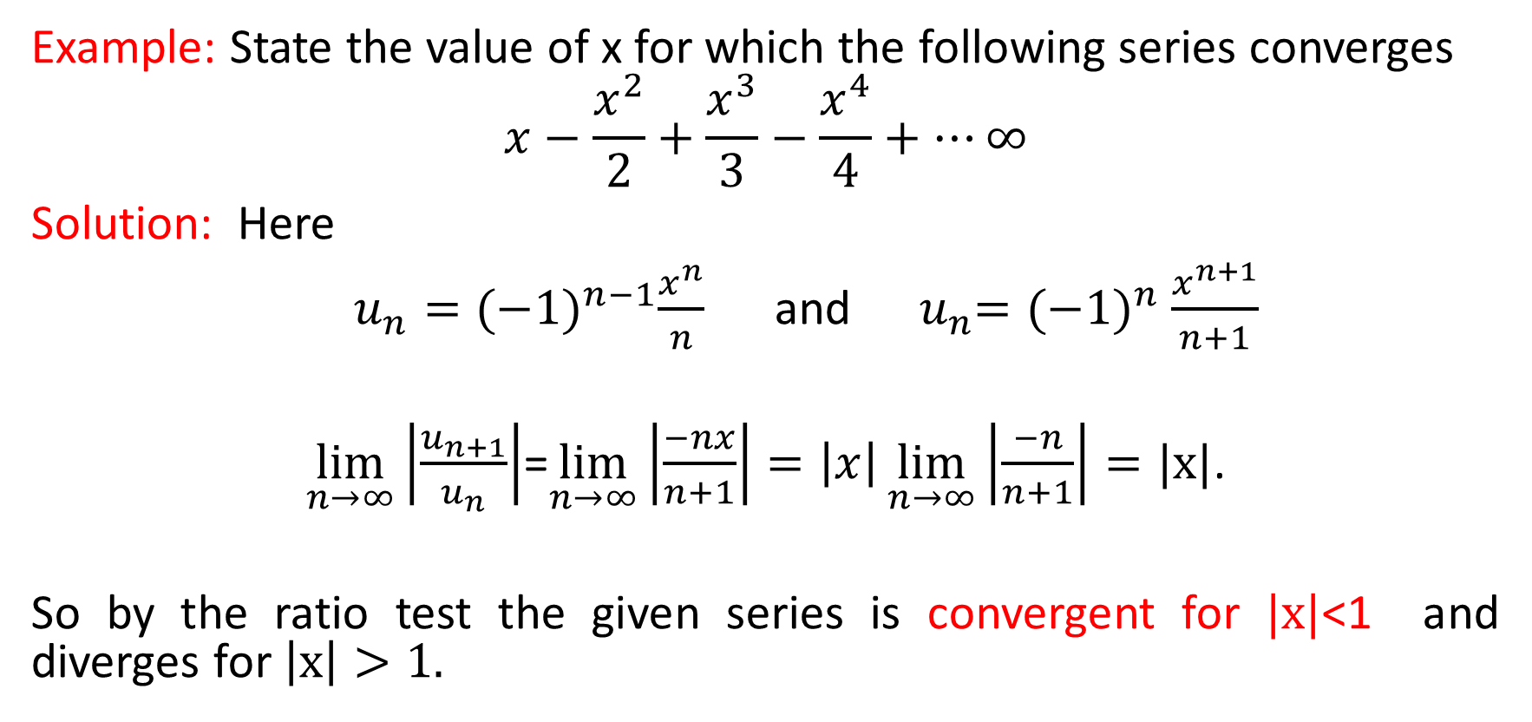

Slide 5
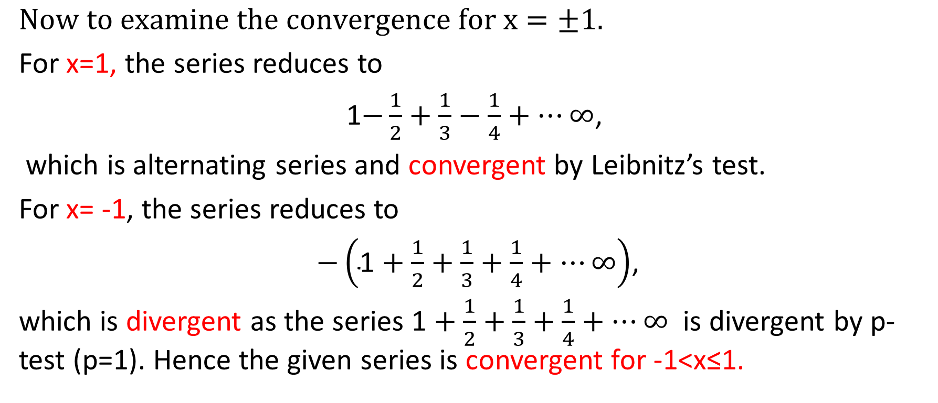
Cont…

Slide 6
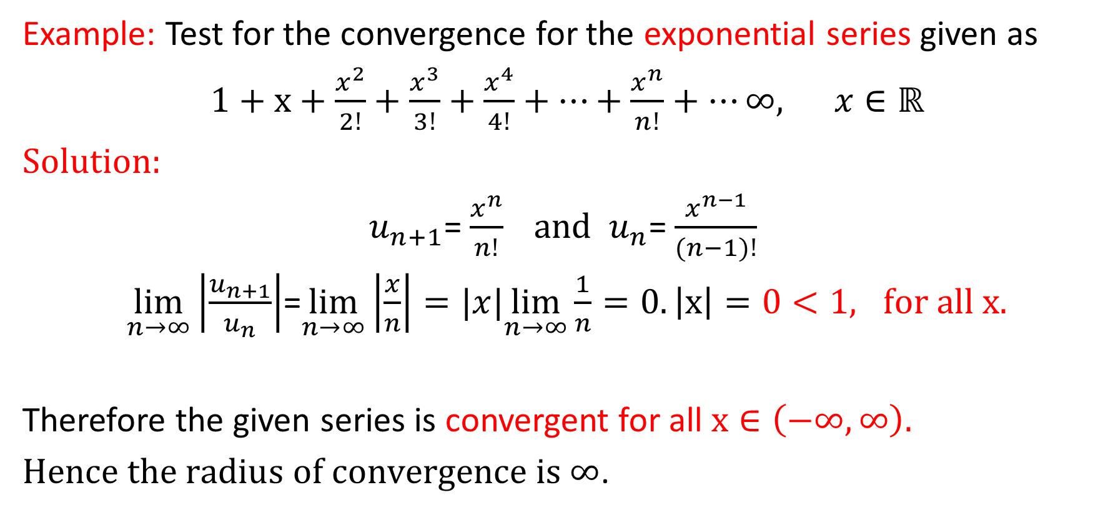

Slide 7
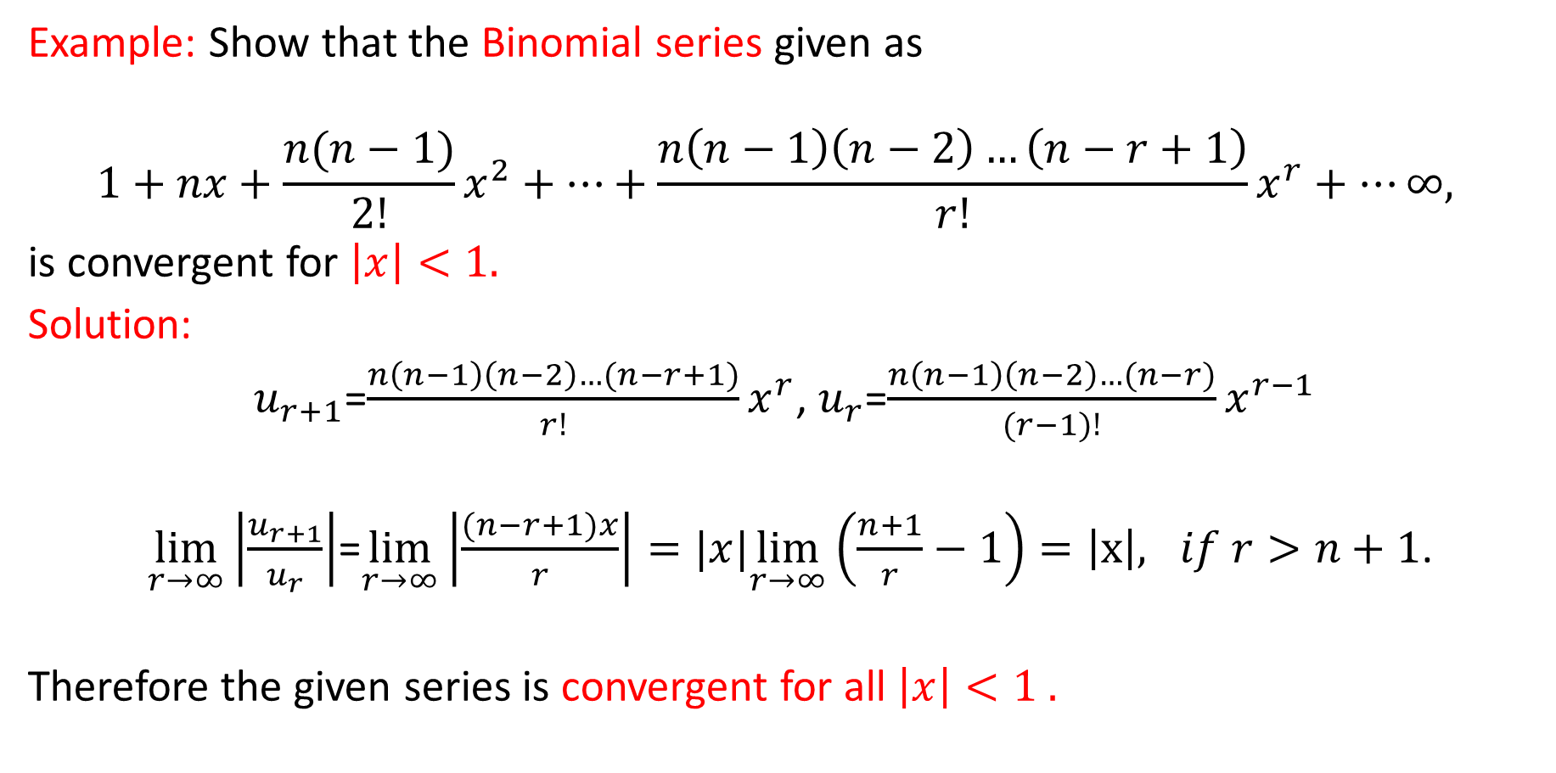

Slide 8
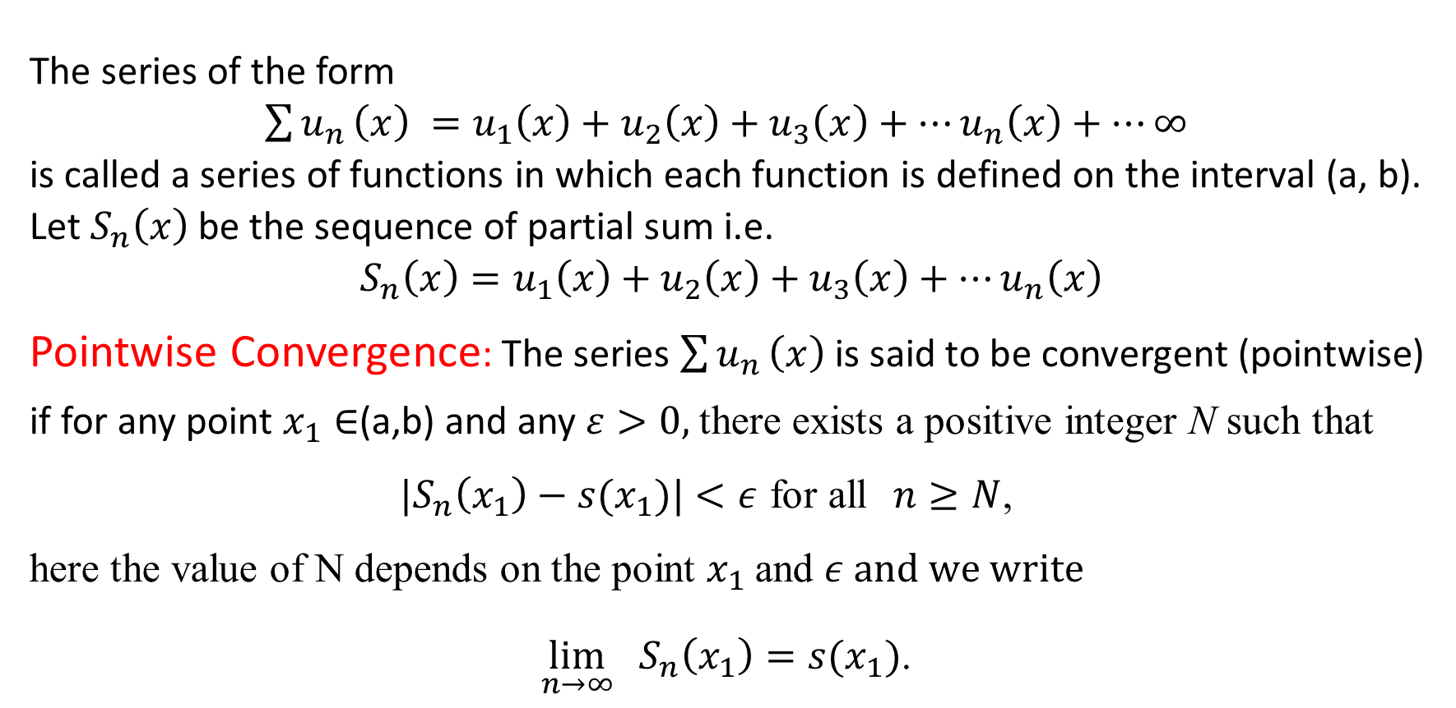
Series of Functions

Slide 9
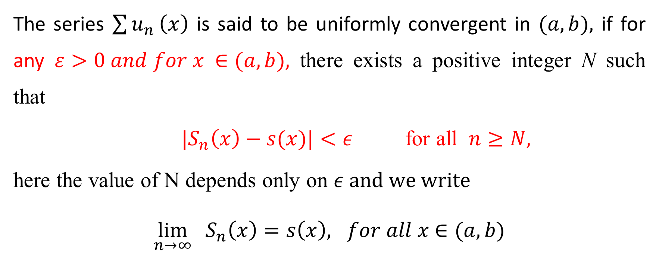
Uniform Convergence

Slide 10
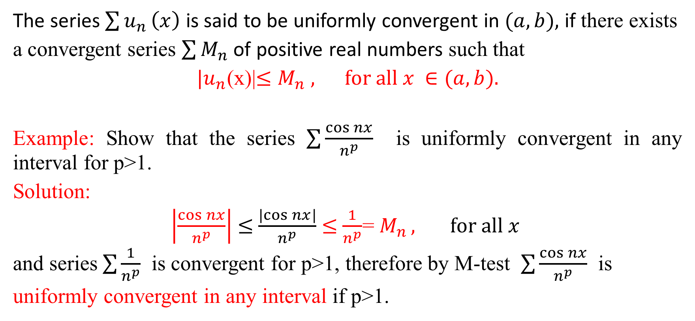
Weierstrass’s M-Test for Uniform Convergence

Slide 11
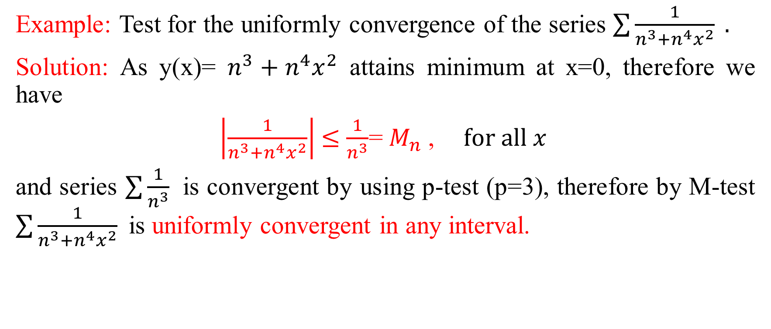

Slide 12
Thank You

